Slide 1
Computer Organization & Assembly Language (CSC-236)
Lecture 13

Slide 2


Slide 3
4.2. SHIFTING AND ROTATIONS
The set of shifting and rotation instructions is one of the most useful set in any processor’s instruction set
They simplify really complex tasks to a very neat and concise algorithm
The shifting and rotation operations which are available in our processor are mentioned in the next slide

Slide 4
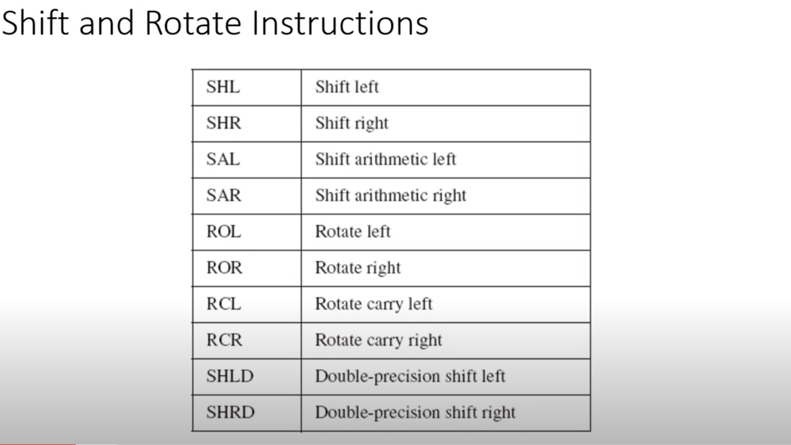

Slide 5
Practise Questions
1.) Write a program that multiplies a number by 2 using the Shift instruction and stores the result in memory.
For Example:
7 * 2 = 14

Slide 6
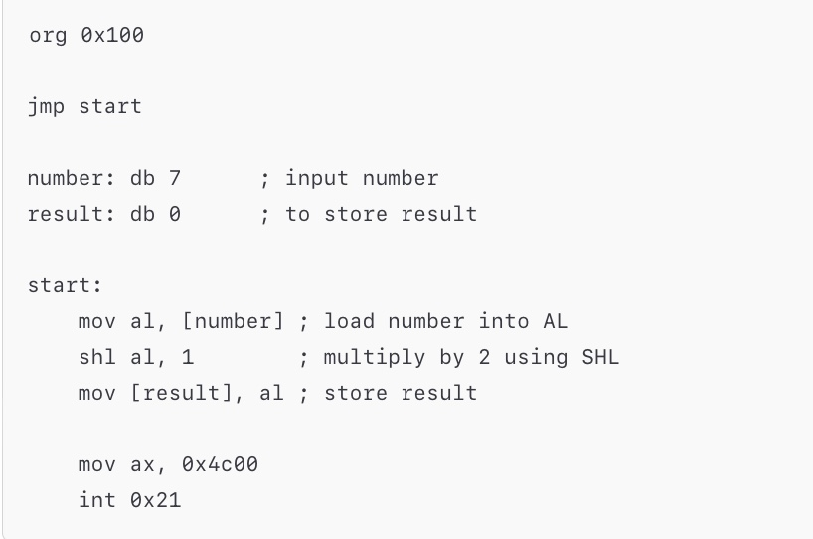
Solution

Slide 7
Practise Questions
2.) Write a program that multiplies a number by 4 using the Shift instruction and stores the result in memory.
For Example:
5 * 4 = 20

Slide 8
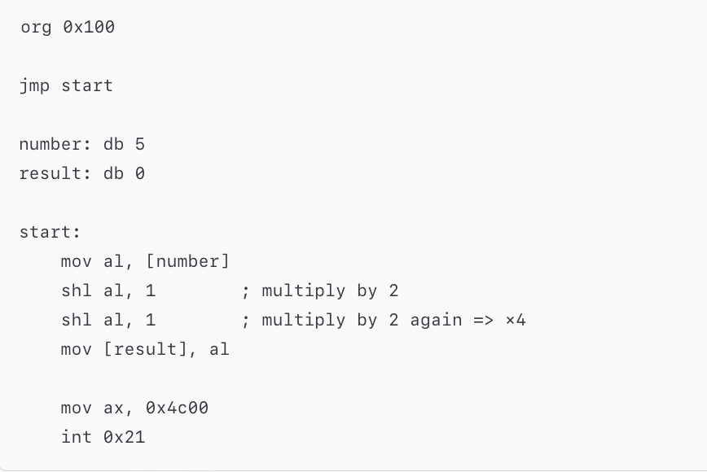
Solution

Slide 9
Practise Questions
3.) Write a program that divides a number by 2 using the shift instruction and stores the result in memory.
For Example:
18 % 2 = 9

Slide 10
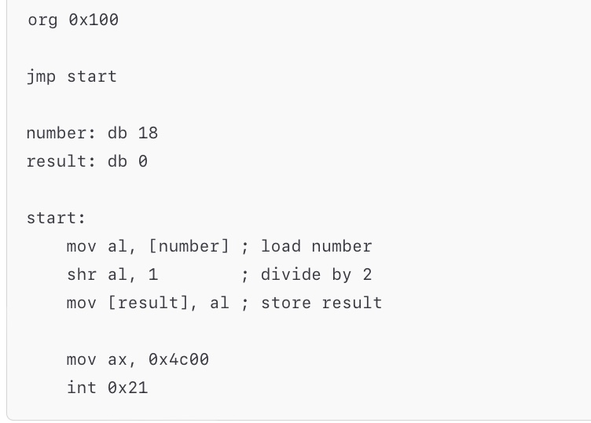
Solution

Slide 11
Practise Questions
4.) Write a program that divides a number by 4 using the shift instruction and stores the result in memory.
For Example:
36 % 4 = 9

Slide 12
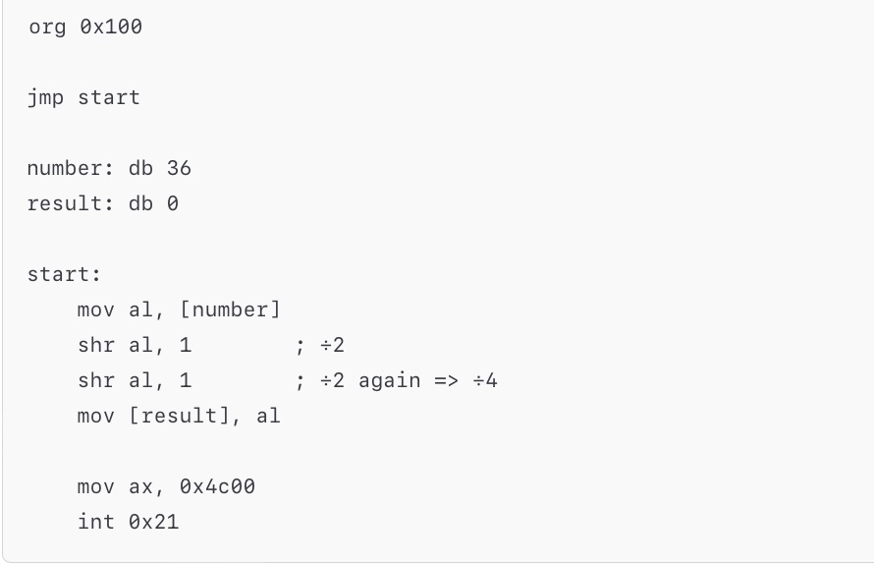
Solution

Slide 13
Practise Questions
5.) Write a program to rotate an 8-bit number left by one bit using ROL and store the result.
Example:
Input = 10110001b → Output = 01100011b

Slide 14
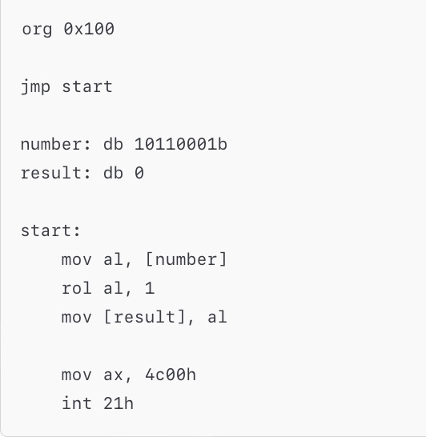
Solution

Slide 15
Practise Questions
6.) Write a program to rotate an 8-bit number right by one bit using ROR and store the result.
Example:
Input = 10110001b → Output = 11011000b

Slide 16
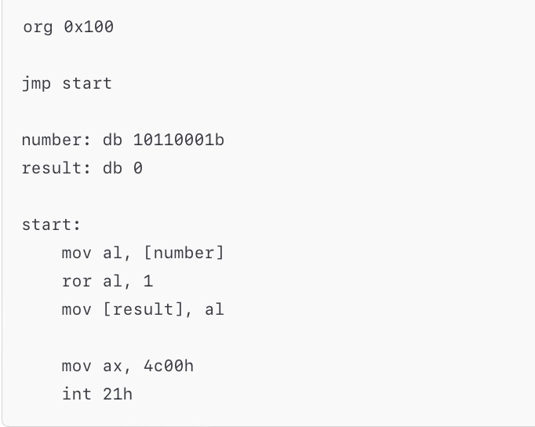
Solution

Slide 17
Practise Questions
7.) Rotate a number right bit-by-bit using ROR and count how many 1s were shifted into the carry flag.

Slide 18
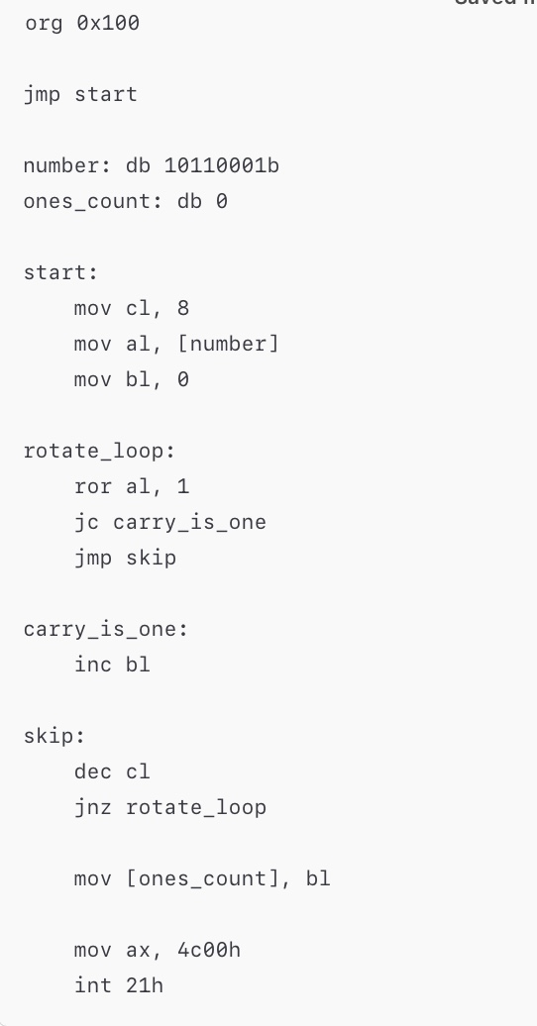
Solution

Slide 19
End of Lecture

